Slide 1
INFORMATION THEORY

Slide 2
COMMUNICATION & ITS NEED
It is the basic step for the exchange of information
When there is a need to exchange information, there arises the issue of the means of communication

Slide 3
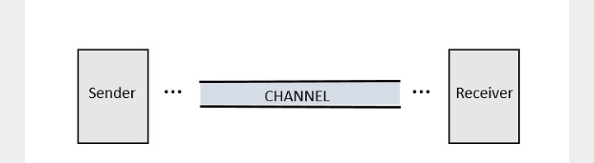
PARTS OF COMMUNICATION SYSTEM
Any system which provides communication, consists of three important and basic parts

Slide 4
The sender is the person who send a message. It could be a transmitting station from where the signal is transmitted
The channel, is the medium through which the message signals travel to reach the destination.
The receiver is the person who receives the message. It could be a receiving station where the signal transmitted is received.

Slide 5
What is a signal
Conveying an information by some means such as gestures, sounds, actions e.t.c. can be termed signaling
Hence signal can eba source of energy which transmits some information. This signal helps to establish communication between a sender and a receiver.
An electrical impulse or an electromagnetic wave which travels a distance to convey a message can be refered to as a signal in communication systems.

Slide 6
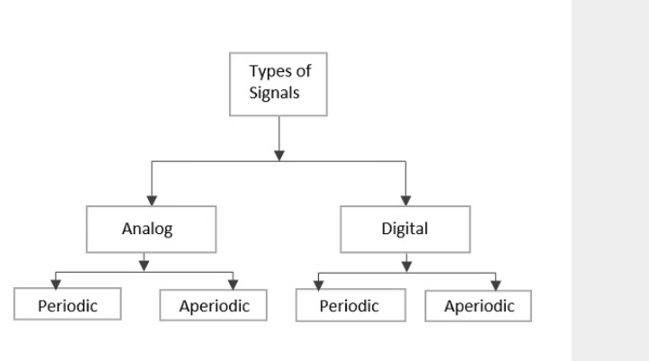
TYPES OF SIGNALS

Slide 7
ANALOG SIGNAL
Are continuous time varying signals, i.e. varies with respect to time e.g consider water running from a tap
The time varying quantity can be understood as Analog quantity
The signal which represents the condition is an analog signal
Communication based on analog signals and analog values is called analog communication

Slide 8
DIGITAL SIGNAL
A signal which is discrete or non-continuous in form, e.g. 20 students in a class, their attendance is not dependent on another but discrete for each student
Has individual values denoted separately not based on the previous values
The binary digits which has only 1s and 0s are mostly termed as digital values
The signals which represent 1s and 0s are called digital signals
The communication based on digital signals and digital values is called Digital communication

Slide 9
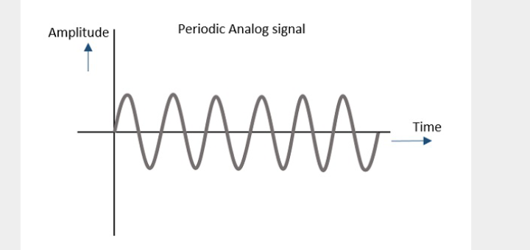
PERIODIC SIGNAL
Any analog or digital signal, that repeats its pattern over a period of time is called a Periodic signal.
The signal has its pattern continued repeatedly
E.g considering the machinery in an industry, the process that takes place is a continuous and repeat procedure
It is easy to be assumed or calculated

Slide 10
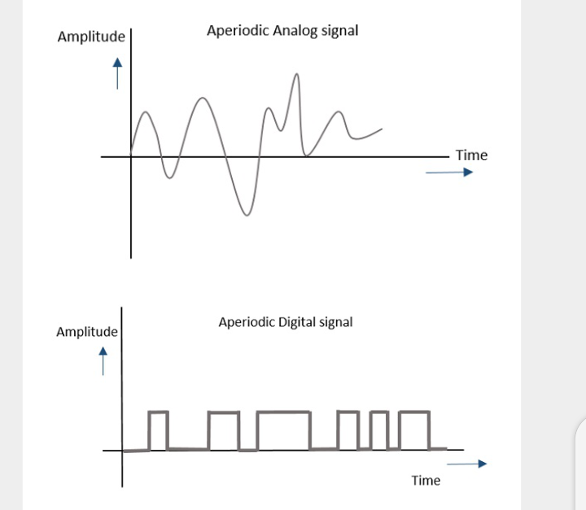
APERIODIC SIGNAL
Any analog or digital signal, that doesn’t repeat its pattern over a period of time is called an Aperiodic Signal
This signal has its pattern continued but not repeated
It is not so easy to be assumed or calculated

Slide 11
MODULATION
For a signal to get transmitted to a distance, without the effect of any external interferences or noise addition and without getting faded away, it has to undergo a process called Modulation

Slide 12
PRINCIPLES OF MODULATION
A signal can be anything like a sound wave which comes out when you shout
A message carrying signal has to get transmitted over a distance and for it to establish a reliable communication, it needs to take the help of a high frequency signal which should not affect the original characteristics of the message signal
A high frequency signal can travels longer distance without getting affected by external disturbances.
The high frequency signal is called a Carrier Signal

Slide 13
Modulation is the process of changing the parameters of the carrier signal, in accordance with the instantaneous values of the modulating signal
In simple terms, it is the backing of an original message by a carrier signal transmitted over a distance to a destination to avoid message loss.
NEED FOR MODULATION
The baseband signals are incompatible for direct transmission. For such a signall, to travel longer distances, its strength has to be increased by modulating with a higher frequency carrier wave, which doesn’t affect the parameters of the modulating signal

Slide 14
What is information theory?
Information is the source of a communication system, whether it is analog or digital.
Information theory is a mathematical approach to the study of coding of information along with the quantification storage, and communication of information

Slide 15
CONDITIONS OF OCCURRENCE OF EVENTS
IF we consider an event there are three conditions of occurrence
If the event has not occurred there is a condition of uncertainity
If the event has just occurred, there is a condition of surprise
If the event has occurred, a time back, there is a condition of having some information.

Slide 16
Hence, these 3 occur at different times.
The difference in these conditions help us have a knowledge on the probabilities of occurrence of events
When we observe the possibilities of occurrence of an event, whether how surprise or uncertain it would be, it means that we are trying to have an idea on the average content of the information from the source of the event.

Slide 17
ENTROPY
Entropy can be defined as a measure of the average information content per source symbol.
Meaning the average level of “information”, “surprise” or “uncertainty” inherent in the variable’s possible outcomes.

Slide 18
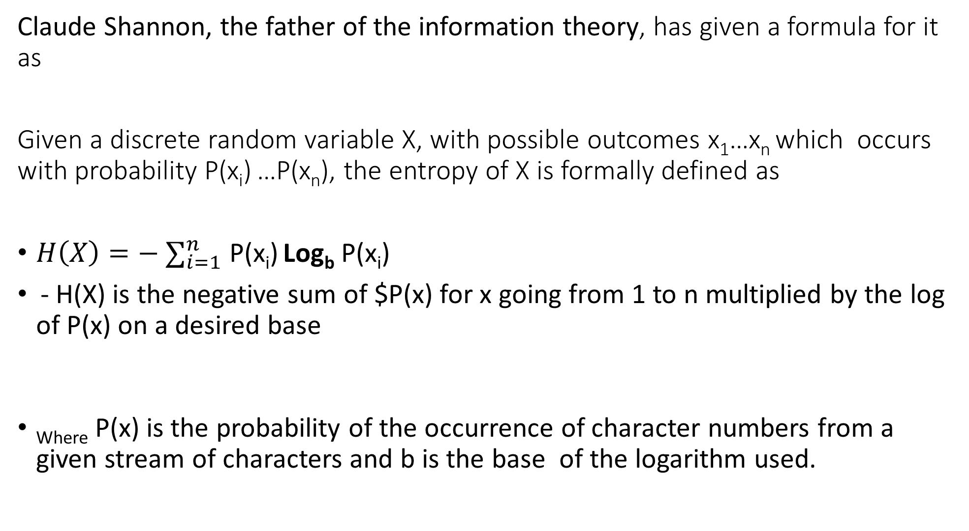
Claude Shannon, the father of the information theory, has given a formula for it as
Given a discrete random variable X, with possible outcomes x₁…x_{n} which occurs with probability P(x_{i}) …P(x_{n}), the entropy of X is formally defined as
$H\left(X\right)=− ∑_{i=1}^{n}$ P(x_{i}) Log_{b} P(x_{i})
- H(X) is the negative sum of $P(x) for x going from 1 to n multiplied by the log of P(x) on a desired base
_{Where} P(x) is the probability of the occurrence of character numbers from a given stream of characters and b is the base of the logarithm used.

Slide 19
DISCRETE MEMORYLESS SOURCE
A source from which the data is being emitted at successive intervals, which is independent of previous values, can be termed DISCRETE MEMORYLESS SOURCE
This source is discrete as it is not considered for a continuous time interval, but at discrete time intervals.

Slide 20
CHANNEL CODING
The channel coding in a communication system, introduces redundancy with control, so as to improve the reliability of the system. Source coding reduces redundancy to improve the efficiency of the system
Channel coding consist of two parts of action:
Mapping
Inverse mapping

Slide 21
CHANNEL PARTS
Mapping: Incoming data sequence into a channel input sequence
Inverse mapping: the channel output sequence into an output data sequence
The final target is that the overall effect of the channel noise should be minimized

Slide 22
The mapping is done by the transmitter with the help of an encoder,, whereas the inverse mapping is done at the receiver by a decoder
A collective class of signaling techniques are employed before transmitting a signal to provide a secure communication, known as the Spread Spectrum Modulation.
The main advantage f spread spectrum communication technique is to prevent interference, whether intentional or unintentional
The signals modulated with these techiques are hard to interfere and cannot be jammed

Slide 23
An intruder with no official access, is never allowed to crack them, hence these techniques are used for military purposes
These spread spectrum signals transmit at low power density and has a wide spread of signals

Slide 24
PSEUDO-NOISE SEQUENCE
A code sequence of 1s and 0s with certain auto-correlation properties is called PseudoNoise coding sequence.
It is used in spread spectrum techniques. It is a maximum-length sequence, which is a type of cyclic code

Slide 25
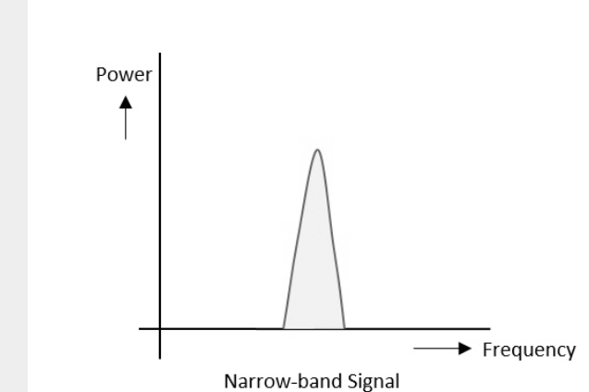
NARROW BAND SIGNAL
These signals have the signal strength concentrated in the frequency spread spectrum as shown in the diagram below

Slide 26
FEATURES OF NARROW-BAND SIGNALS
Band of signals occupy narrow range of frequencies
Power of density is high
Spread of energy is low and concentrated
Signals are prone to intereference

Slide 27
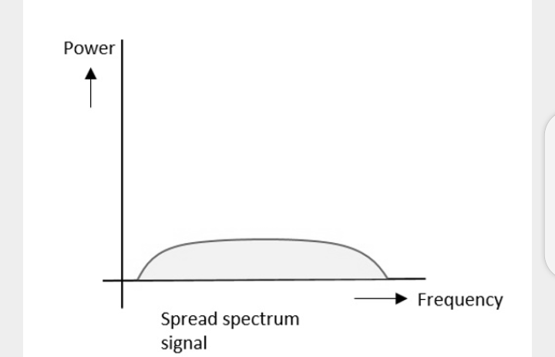
SPREAD SPECTRUM SIGNALS
The spread spectrum signals have the signal strength distributed as show in the figure below

Slide 28
FEATURES OF SPREAD SPECTRUM
Band of signals occupy a wide range of frequencies
Power density is very low
Energy is widespread
Spread spectrum signals are highly resistant to interference or jamming.
Multiple users can share the same spread spectrum bandwith without interfering with one another. These are called multiple access techniques.

Slide 29
Spread spectrum multiple access tecniques use signals which have transmission bandwith whose magnitude is grater than the minimum required Radio Frequency bandwidth.
Spread spectrum signals can be classified into two categories
1. frequency hopped spread spectrum(FHSS)
Direct Sequence spread spectrum (DSSS)

Slide 30
FREQUENCY HOPPED SPREAD SPECTRUM
Users are made to change the frequencies of usage, from one to another in a specified time interval. This is called FREQUENCY HOPPING
E.g a frequency was allotted to sender 1 for a particular period of time, after a while, sender 1 hops to the other frequency and sender 2 uses the first frequency, which was previously used by sender 1. this is called Freqency reuse

Slide 31
The frequencies of the data are hopped from one to another in order to provide secure transmission. The amount of time spent on each frequency hop is called Dwell time

Slide 32
DIRECT SEQUENCE SPREAD SPECTRUM
Whenever a user wants to send data using this DSSS technique, each and every bit of the user data is multiplied by a secret code, called CHIPPING CODE
chipping code is the spreading code which is multiplied with te original message transmitted
The receiver uses the same code to retrieve the original message
The DSSS is also called CODE DIVISION MULTIPLE ACCESS(CDMA)

Slide 33
Comparison of FHSS and DSSS/CDMA
FHSS | DSSS
Multiple frequencies are used | Single frequency is used
Hard to find the user’s frequency at any instance of time | User frequency, once allotted is always the same
Frequency resue is allowed | Frequency reuse is not allowed
The sender need not wait | The sender has to wait if the spectrum is busy
Power strength of the signal is high | Power strength of the signal is low
It is stronger and penetrates through the obstacles | It is weaker compared to FHSS
It is never affected by interference | It can be affected by interference
It is cheaper | It is expensive
This is the mostly used technique | This is not frequently used

Slide 34
Advantages of spread spectrum
Cross talk elimination
Better output with data integrity
Reduced effect of multipath fading
better security
Reduction in noise
Co-existence with other systems
Longer operative distances
Hard to detect
Hard to demodulate/decode
Harder to jam the signals

Slide 35
Assignment: submit by next class
List five areas where spread spectrum is been used and which is used, the limitations of the system

Slide 36
Modulation is the process of changing the parameters of the carrier signal, in accordance with the instantaneous values of the modulating signal
In simple terms, it is the backing of an original message by a carrier signal transmitted over a distance to a destination to avoid message loss.
NEED FOR MODULATION
The baseband signals are incompatible for direct transmission. For such a signal, to travel longer distances, its strength has to be increased by modulating with a higher frequency carrier wave, which doesn’t affect the parameters of the modulating signal

Slide 37
Advantages of Modulation
Without modulation, the antenna used for transmission would have to be very large.
The range of communication gets limited as the wave cannot travel to a distance without getting distorted, i.e. no signal mixing occurs
Communication range increases
Multiplexing of signals occur
Adjustments in the bandwidth is allowed

Slide 38
Signals in the Modulation Process
Three types of signals in the modulation process:
Message or modulating signal –
the signal which contains a message to be transmitted is called a message signal or modulating signal
It is a baseband signal, which has to undergo the process of modulation to get transmitted
Carrier signal
The high frequency signal which has a certain phase, frequency and amplitude but contains no information is called the carrier signal.
It is an empty signal
It is just used to carry the signal to the receiver after modulation
Modulated signal
The resultant signal after the process of modulation, is called the modulated signal.
Modulated Signal = the modulating signal + the carrier signal

Slide 39
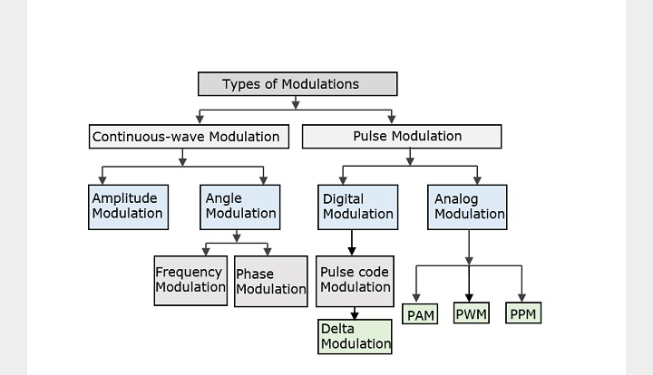
Types of modulation
There are many types of modulation, depending on the modulation technique used

Slide 40
The types of modulations are broadly classified into continuous-wave modulation and pulse modulation
Continuous-wave modulation
A high frequency sine wave is used as a carrier wave
Continuous wave goes on continuously without any intervals and it is a baseband message signal, which contains the information. This wave has to be modulated
It is divided into amplitude and angel modulation
Amplitude modulation
If the amplitude of the high frequency carrier wave is varied in accordance with the instantaneous amplitude of the modulating signal, then such a technique is called amplitude modulation, the figure describes it better

Slide 41
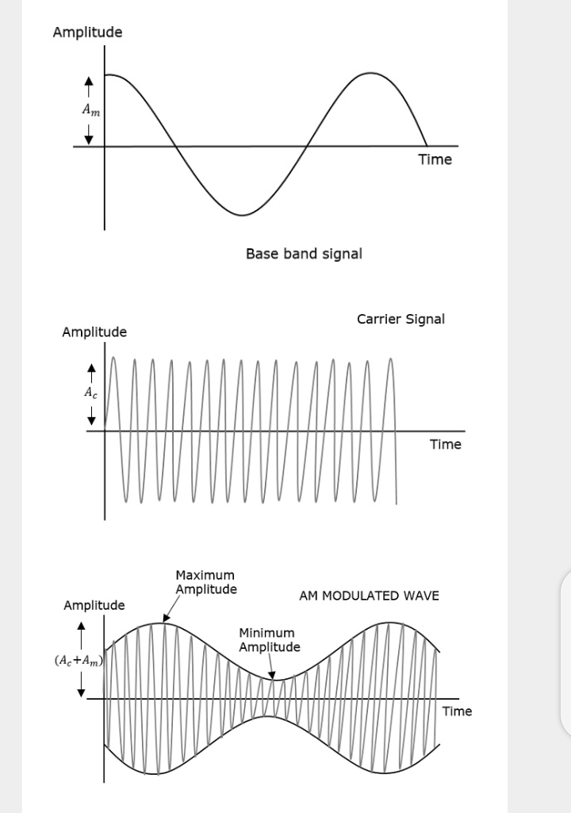
The modulating wave which is shown first is the message signal.
The next one is the carrier wave, which is just a high frequency signal and contains no information
The last one is the modulated wave
You can see that the positive and negative peaks of the carrier wave, are interconnected with an imaginary line.
This line helps recreate the exact shape of the modulating signal.
This imaginary line on the carrier wave is called Envelope
It is the same as the message signal

Slide 42
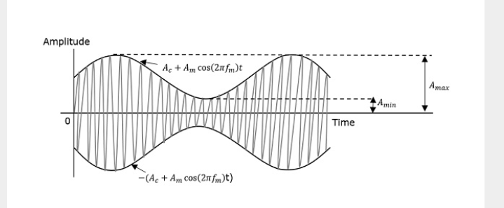
Modulated Index
A carrier wave, after being modulated, if the modulated level is calculated, then such an attempt is called Modulation Index or Modulation Depth
Ut states the level of modulation that a carrier wave undergoes

Slide 43
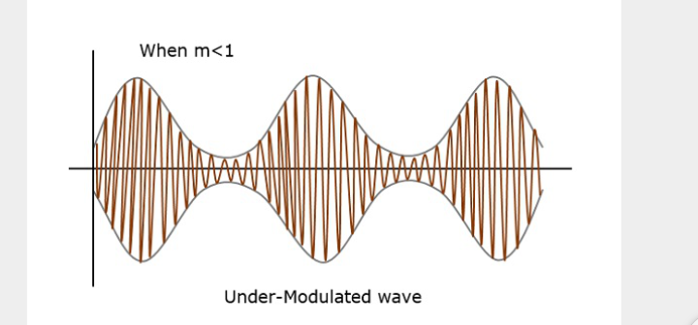
The maximum and minimum values of the envelope of the modulated wave are represented by A_{max} and A_{min respectively}
For a perfect modulation, the value of modulation index should be 1, which means the modulation depth should be 100%
For instance if this value is less than 1 i.e., the modulation index is 0.5, then the modulated output would be said to be under-modulated wave and would look like the following figure

Slide 44
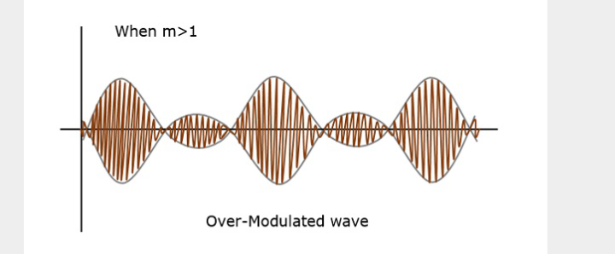
If the value of the modulation index is greater than 1 i.e., 1.5 or so, then the wave will be an over-modulated wave. It would look like this
As the value of the modulation index increases, the carrier experiences a 180⁰ phase reversal, which causes additional sidebands and hence the wave gets distorted.
Such over-modulated wave causes interference, which cannot be eliminated

Slide 45
Bandwidth of Amplitude Modulation
The bandwidth is the difference between lowest and highest frequencies of the signal
The bandwidth required for the amplitude modulated wave is twice the frequency of the modulating signal

Slide 46
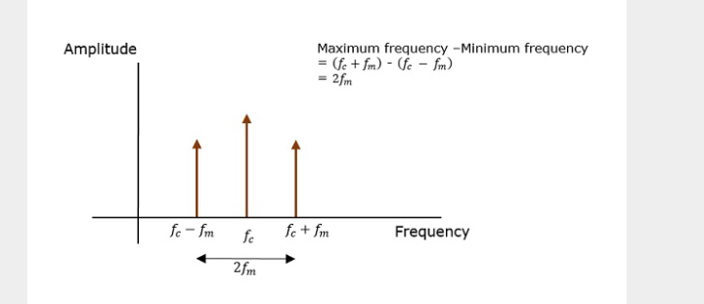
Sideband Modulation
In the process of Amplitude Modulation or Phase Modulation, the modulated wave consists of the carrier wave and two sidebands.
a sideband is a band of frequencies containing power, which are the lower and higher frequencies of the carrier frequency.
Both the sidebands contain the same information.
The representation of amplitude modulated wave in the frequency domain is as shown in the figure

Slide 47
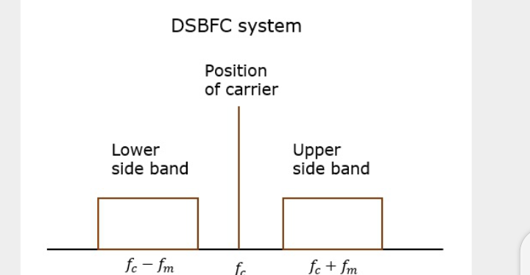
Both the sidebands in the image contain the same information. The transmission of such a signal which contains a carrier along with two sidebands, is termed Double Sideband Full Carrier system or DSB-FC
Such a transmission inefficient. Two-thirds of the power is been wasted in the carrier, which carries no information

Slide 48
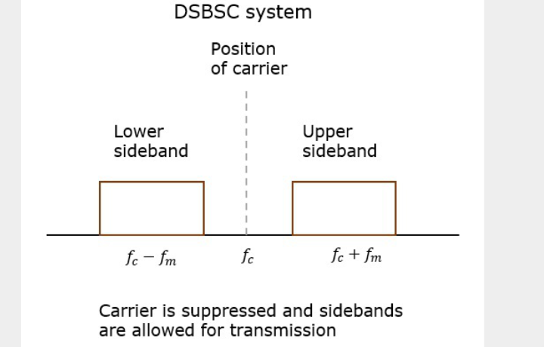
If this carrier is suppressed and the power saved is distributed to the two sidebands, such a process is called as Double Sideband Suppressed Carrier system.
The process of suppressing one of the sidebands along with the carrier and transmitting a single sideband is called Single Sideband Suppressed Carrier system or SSB-SC or SSB.

Slide 49
This SSB which transmits a single sideband has high power, as the power allotted for both the carrier and the other sideband is utilized in transmitting the SSB
Modulation done using SSB is called SSB modulation

Slide 50
Advantages and disadvantages of Sideband Modulation
 | Disadvantages
Bandwidth or spectrum space occupied is less than AM and DSB signals | The generation and detection of SSB signal is a complex process
Transmission of more number of signals is allowed | Quality of the signal gets affected unless the SSB transmitter and receiver have an excellent frequency stability
Power is saved
High power signal can be transmitted
Signal fading is less likely to occur

Slide 51
Application of SSB modulation
For power saving requirements and low bandwidth requirement
In land, air and maritime mobile communications
In point-to-point communications
In radio communications
In television, telemetry and radar communications
In military communications, such as amateur radio, etc

Slide 52
Vestigial (Meaning “Part”)Sideband (VSB)
In practice when sideband is passed through the filters, the band pass filter may not work hence some of the information may get lost
To avoid this loss, a technique which is a compromise between DSB-SC and SSB called VSB technique is used.
In VSB –
Part of the signal called vestige is modulated along with one sideband
Along with the upper sideband, apart of the lower sideband is also being transmitted
A guard band of very small width is laid on either side of VSB in order to avoid interferences.
Used mostly in television transmission

Slide 53
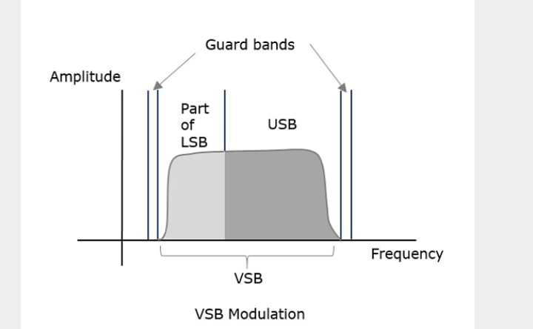

Slide 54
Advantages and disadvantages of VSB
Advantages | Disadvantages
Highly efficient | Bandwidth when compared to SSB is greater
Reduction in bandwidth | Demodulation is complex
The transmission of low frequency components is possible, without difficulty
Possesses good phase characteristics
Most convenient and efficient technique when bandwidth usage is considered

Slide 55
Angle modulation
It is the process in which the frequency or the phase of the carrier caries according to the message signal
If the angle of the carrier wave is varied, in accordance with the instantaneous value of the modulating signal, the technique is called Angle Modulation
It is further divided into frequency and phase modulation
Frequency modulation (FM) –
if the frequency of the carrier wave is varied in accordance with the instantaneous value of the modulating signal, then such a technique is called frequency modulation
The amplitude and the phase of the carrier signal remains constant whereas the frequency of the carrier changes.

Slide 56
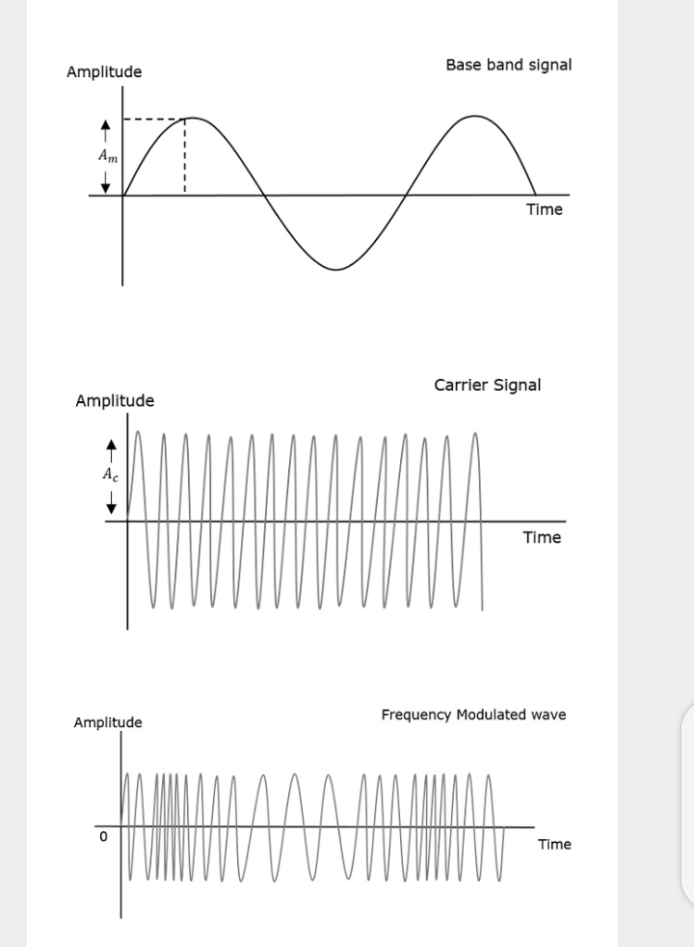

Slide 57
The frequency of the modulated wave remains constant as the carrier wave frequency when the message signal is at zero.
The frequency increases when the message signal reaches its maximum amplitude
FM can be divided into –
Narrowband FM
This frequency modulation has small bandwidth
The modulation index is small
Its spectrum consists of carrier, upper sideband and lower sideband
Used in mobile communications such as police wireless, ambulances etc.
Wideband FM
Frequency modulation has infinite bandwidth
Modulation index is larger i.e. higher than 1
Its spectrum consist of a carrier and infinite number of sidebands, which are located around it
Used in entertainment broadcasting applications such as FM radio, TV etc.

Slide 58
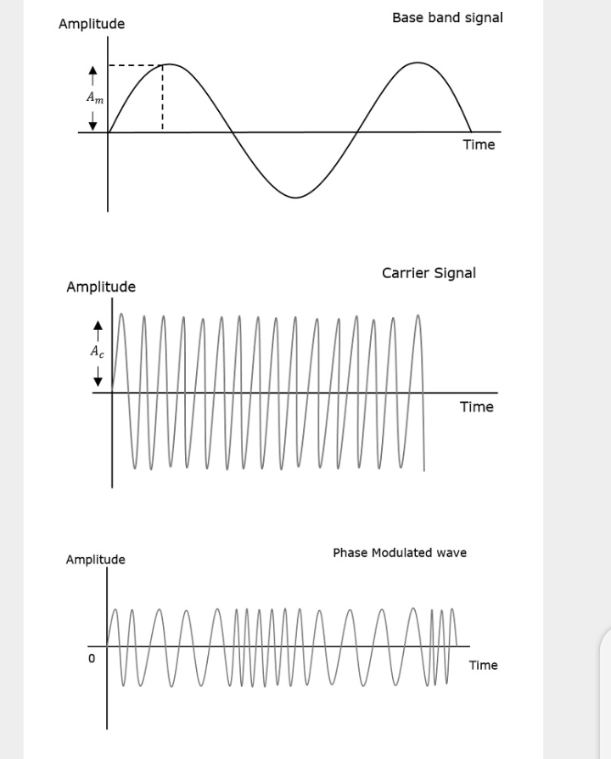
Phase modulation (PM) –
if the phase of the high frequency carrier wave is varied in accordance with the instantaneous value of the modulating signal, then the technique is called phase modulation
The amplitude and the frequency of the carrier signal remains constant whereas the phase of the carrier changes.

Slide 59
The phase of the modulated wave has got infinite points where the phase shift in a wave can take place
The instantaneous value of the modulating signal changes the phase of the carrier
When the value is positive, the phase changes in one direction and if negative, the phase changes in the opposite direction

Slide 60
Pulse Modulation
A periodic sequence of rectangular pulses, is used as carrier wave
It is divided into analog and digital modulation
In Analog modulation technique –
if the amplitude, duration or position of a pulse is varied in accordance with the instantaneous values of the baseband modulating signal, then such a technique is called Pulse Amplitude Modulation (PAM) or Pulse Duration/Width Modulation( PWM) or Pulse Position Modulation (PPM)
Digital modulation -
the modulation technique used is Pulse Code Modulation (PCM) ,
The analog signal is converted to digital form from 1s and 0s. The resultant is a coded pulse train
Hence PCM is a technique where the analog signals are converted into digital form

Slide 61
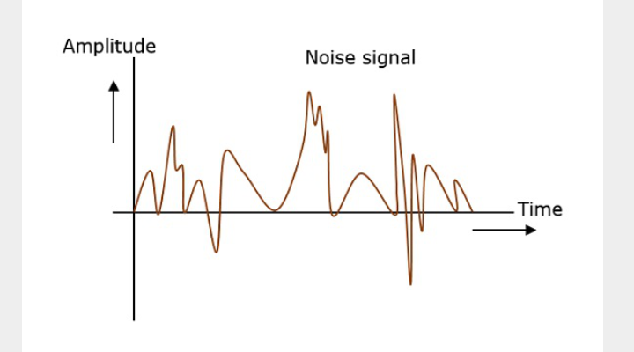
Principles of communication- Noise
Noise is unwanted signal which interferes with the original message signal and corrupts the parameter of the message signal.
It is most likely to be entered at the channel or the receiver

Slide 62
Noise is some signal which has no pattern and no constant frequency or amplitude.
Examples of noise – Hiss (Sound in radio receivers ), Buzz (sound amidst of telephone conversation), Flicker (in television receivers)
Effect of noise:
It limits the operating range of the systems
Indirectly places limit on the weakest signal that can be amplified by an amplifier.
The oscillator in a mixer circuit may limit its frequency because of noise
Limits the smallest signal that a receiver is capable of processing
Affects the sensitivity of receivers ( sensitivity is the minimum amount of input signal necessary to obtain the specified quality output)

Slide 63
Types of noise
Classification is based on the source, the effect it shows or the relation it has with the receiver
2 main ways in which noise is produced
External source –
May occur in the medium or channel of communication
Cannot be completed eliminated
Best way is to avoid the noise from affecting the signal
Examples – atmospheric noise, extra-terrestrial noise (solar noise and cosmic noise),industrial noise
Internal source –
Produced by the receiver component while functioning i.e. noise generated by components in the circuits due to continuous functioning
The noise is quantifiable
A proper receiver design may lower the effect of this noise
Examples – thermal agitation(electrical noise),shot noise (due to random movement of electrons and holes), transit-time noise (during transistion), miscellaneous noise (includes, flicker, resistance effect and mixer generated noise e.t.c.)

Slide 64
Signal-to-noise ratio (SNR)
Signal-to-noise ration is the ratio of the signal power to the noise power
The higher the SNR, the greater will be the quality of the received output
ANALYSING SIGNALS
To analyse a signal, it has to be represented.
This representation in communication systems is of two types
Frequency domain representation
Time domain representation
Consider two signals with 1kHz and 2kHz frequencies. Both of them are represented in time and frequency domain as shown in the figure below

Slide 65
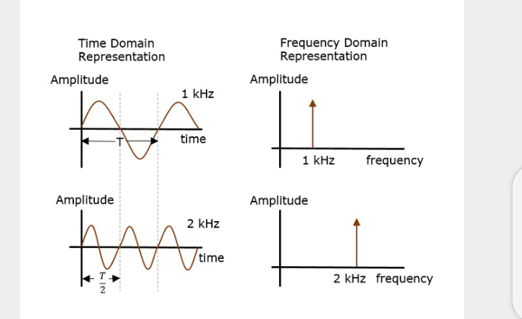
Time domain analysis, gives the signal behavor over a certain time period. In the frequency domain, the signal is analyzed as a mathematical function with respect to the frequency domain

Slide 66
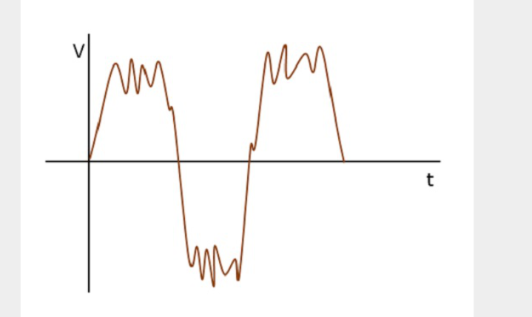
Frequency domain representation is needed where the signal processing such as filtering, amplifying and mixing are done
For instance, if a signal such as the figure below is considered
It is understood that noise is present in it

Slide 67
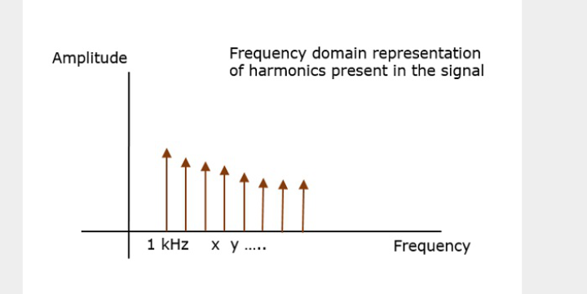
The frequency of the original signal may be 1kHz, but the noise of certain frequency, which corrupts this signal is unknown.
However, when the same signal is present in the frequencydomain, using a spectrum analyzer, it is plotted as shown in the figure below
We observe few harmonics, which represent the noise introduced into the original signal.

Slide 68
Hence the signal representation helps in analyzing the signals
Frequency domain analysis helps in creating the desired wave patterns
Time domain analysis helps to understand such bit patterns

